Slide 1
Superstore - Retail Sales

Slide 2
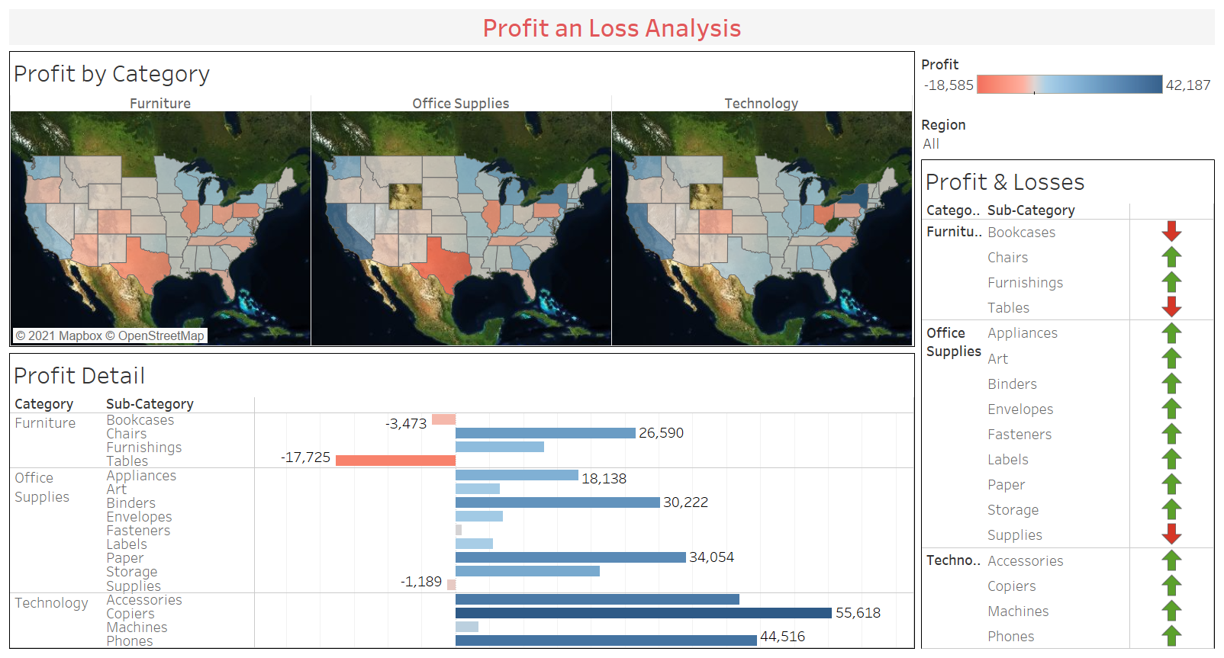

Slide 3
